Slide 1
Navigation

Slide 2
React Navigation
Large number of contributors
Documentation
Can be integrated with existing native code
Redux
Easy to get going
Apps do not have a ‘native feel’
Users may notice transitions between native and react-native

Slide 3
Native Navigation
App has a ‘native feel’
Smooth transitions between native and react-native code
AirBnb developed specifically for hybrid apps
Lack of contributors (2 people)
AirBnB are currently not prioritizing
Poor documentation
Poor support for issues
TabBar
Different code structure

Slide 4
React Native Navigation
Better native feel than react navigation
Good number of contirbutors (growing)
Good documentation
Different code structure

Slide 5
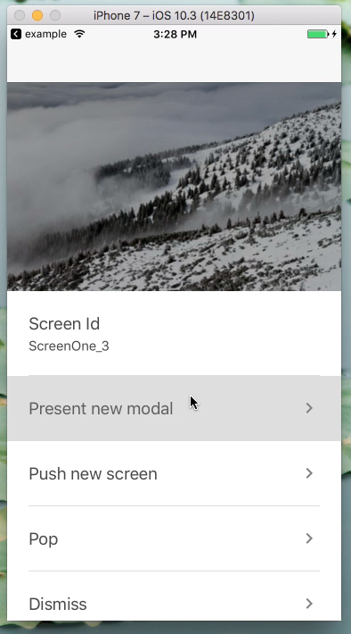
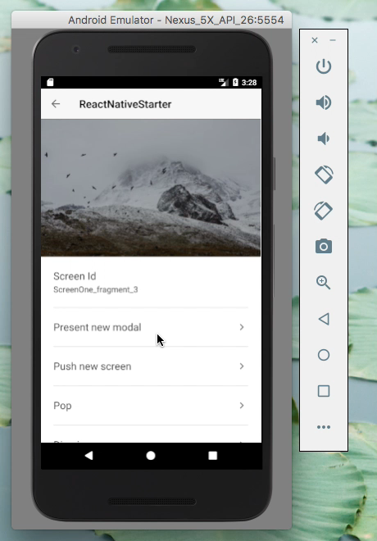
Native navigation AirBnB Demo

Slide 6
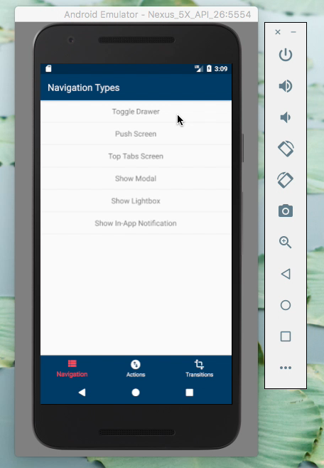
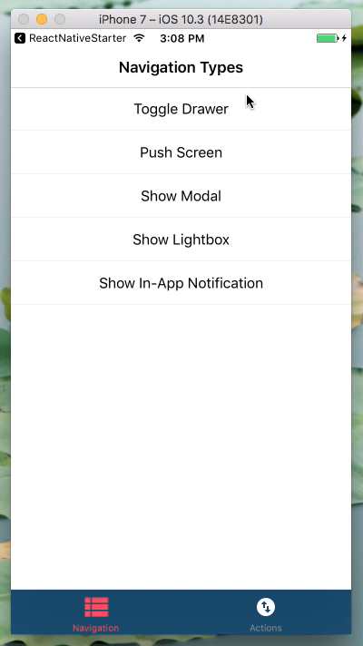
React Native Navigation

